Slide 1
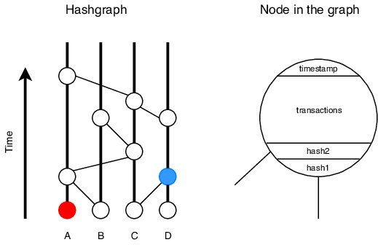
Hashgraph Data Struct
Each relay is a line on the graph directed up. Each event is a node. Transactions are relay samples for the respective relay with a self-parent connection and a connection to the node that initiated the sync.

Slide 2
Hashgraph in an ICS
Ensures data integrity under the following two assumptions:
Each sub-station is geographically separated
Data cannot be manipulated simultaneously by an outsider threat in over 1/3 of the network
Each relay is a node in the network
Every time a new “event” is created, the relay connected to that node is sampled

Slide 3
Hashgraph’s Highly Secure Algorithm
Hashgraph is validated as asynchronous Byzantine Fault Tolerant (ABZT)
Offers the highest level of security for a distributed system like ICS
Currently a replacement for Blockchain for an intended use in cryptocurrency applications
Repurposed to operate within out microgrid testbed

Slide 4
Hashgraph Implementation
Individual Raspberry Pis connected to each relay
Each Pi runs it’s own Hashgraph script in python
Scripts use multithreading to send and receive data asynchronously
Each Pi runs on its own without a centralized authority
Anomalies or incorrect data will be detected using this system

